Slide 2
How does Data Conflict Occur in DBMS?
Data is saved into the database. And to fetch and write data from the database, you need to perform read and write operation on the data.
There are multiple entities (multiple users, multiple APPs, multiple websites…) performing these multiple operations on the same data at the same time.
Just as an instance, there is a centralized banking database where all the information about the users and the bank related information is saved.
There might be multiple user logins to their bank account and access the same bank information at the same time. They perform various operations like reading or updating or deleting the data.

Slide 3
So basically there are two types of operations that can be performed on the database.
1. Read operation:
Read the data value from the database. It is a safe operation, as it does not update any information in the database.
2. Write operation:
It writes data into the database and saved it for further use. After writing data, data has to be committed (Commit Operation) to making updated information available for further operations. This operation is more prone to vulnerability as it involves modifying database information.
For a data update operation, it involves both the reading and writing operation.
What is Transaction in Database?
The set of these multiple operations/instruction (to accomplish a particular task) are performed on the data. This set is called as Transaction.
Every entity accessing data holds different transaction and all the transactions execute simultaneously.

Slide 4
The operations involved in the successful Transaction:
Read the data
Modify read data values
Write the data back
Commit the transaction
While performing these operations by the different users on the same data at the same time may arise data conflict. As like, accessing data by one transaction before committing another transaction does not hold good and gives data conflict.
There are different types of data conflict happens during reading and writing operations called as “Read-Write conflict”.

Slide 5
So, there are three types of conflict in the database transaction.
Write-Read (WR) conflict
Read-Write (RW) conflict
Write-Write (WW) conflict
What is Write-Read (WR) conflict?
This conflict occurs when a transaction read the data which is written by the other transaction before committing.

Slide 6
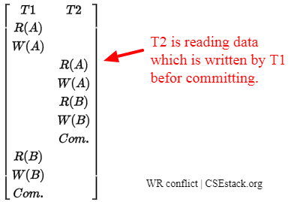
Here, the transaction T2 is reading the data which is written by the T1 before T2 commits. It is also called as Dirty Read.
It violates the ACID property of data consistency rule.

Slide 7
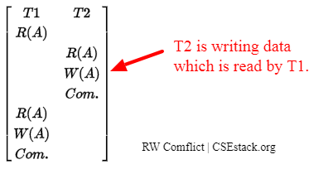
What is Read-Write (RW) conflict?
Transaction T2 is Writing data which is previously read by transaction T1.
Here if you look at the diagram above, data read by transaction T1 before and after T2 commits is different.
Example:
Suppose Alice and Bob want to book the flight for their vacation. Alice open airlines website to check the availability and cost of the ticket. There is only one ticket is available. Alice finds it expensive and looks for other airlines fares if she gets any offers.
Meanwhile, Bob logins to the same airline portal and book the ticket. Now, there is no more flight ticket available. Alice does not find any good offer on other airlines portal, she comes back to the previous airline portal. And tried to book a flight ticket even it is not available. Its Conflict, Read-Write (WR) conflict.

Slide 8
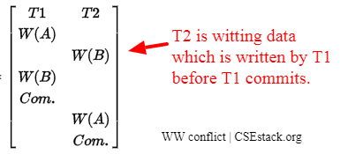
What is Write-Write (WW) conflict?
Here Transaction T2 is writing data which is already written by other transaction T1. T2 overwrites the data written by T1. It is also called as a blind write operation.
Data written by T1 has vanished. So it is data update loss.
Example:
Alice and Bob share common Google-sheet online. Both read the file. Alice updates the document and forgets to save the file. On another end, Bob updates the Google sheet and save the file.
The content updated by Alice is overwritten by Bob. The data updated by Alice is lost. It is called as Write-Write (WW) conflict.

Slide 9
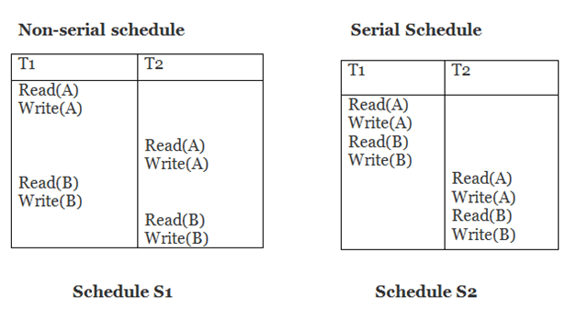

Slide 10
Problem-01:
Check whether the given schedule S is conflict serializable or not-
S : R₁(A) , R₂(A) , R₁(B) , R₂(B) , R₃(B) , W₁(A) , W₂(B)

Slide 11
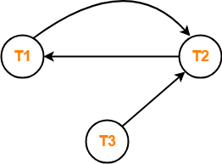
List all the conflicting operations and determine the dependency between the transactions-
R₂(A) , W₁(A) (T₂ → T₁)
R₁(B) , W₂(B) (T₁ → T₂)
R₃(B) , W₂(B) (T₃ → T₂)
Clearly, there exists a cycle in the precedence graph.
Therefore, the given schedule S is not conflict serializable

Slide 12
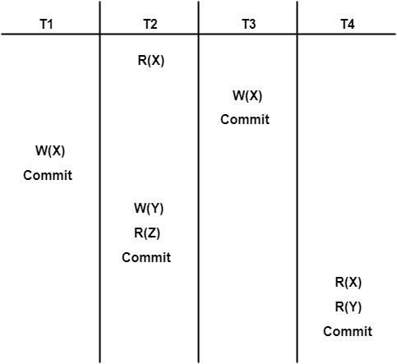
Check whether the given schedule S is conflict serializable or not. If yes, then determine all the possible serialized schedules-

Slide 13
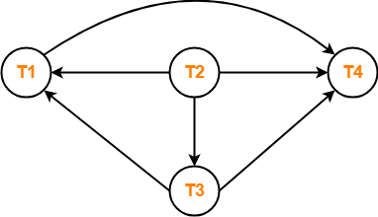
R₂(X) , W₃(X) (T₂ → T₃)
R₂(X) , W₁(X) (T₂ → T₁)
W₃(X) , W₁(X) (T₃ → T₁)
W₃(X) , R₄(X) (T₃ → T₄)
W₁(X) , R₄(X) (T₁ → T₄)
W₂(Y) , R₄(Y) (T₂ → T₄)
Clearly, there exists no cycle in the precedence graph.
Therefore, the given schedule S is conflict serializable.

Slide 14
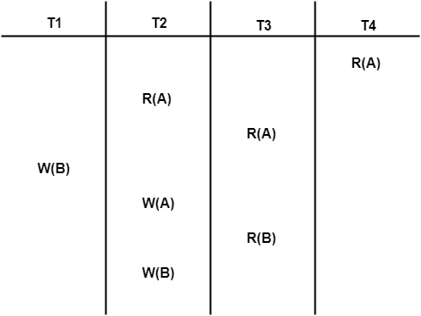
Check whether the given schedule S is conflict serializable or not. If yes, then determine all the possible serialized schedules-

Slide 15
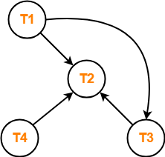
List all the conflicting operations and determine the dependency between the transactions-
R₄(A) , W₂(A) (T₄ → T₂)
R₃(A) , W₂(A) (T₃ → T₂)
W₁(B) , R₃(B) (T₁ → T₃)
W₁(B) , W₂(B) (T₁ → T₂)
R₃(B) , W₂(B) (T₃ → T₂)

Slide 16
After performing the topological sort, the possible serialized schedules are-
T₁ → T₃ → T₄ → T₂
T₁ → T₄ → T₃ → T₂
T₄ → T₁ → T₃ → T₂

Slide 17
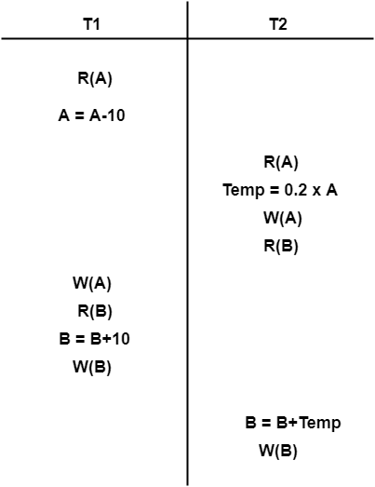

Slide 18
Consider the transactions T1, T2, and T3 and the schedules S1 and S2 given below.
T1: r1(X); r1(Z); w1(X); w1(Z)
T2: r2(Y); r2(Z); w2(Z)
T3: r3(Y); r3(X); w3(Y)
S1: r1(X); r3(Y); r3(X); r2(Y); r2(Z);
w3(Y); w2(Z); r1(Z); w1(X); w1(Z)
S2: r1(X); r3(Y); r2(Y); r3(X); r1(Z);
r2(Z); w3(Y); w1(X); w2(Z); w1(Z)
Which one of the following statements about the schedules is TRUE?
a. | Only S1 is conflict-serializable
b. | Only S2 is conflict-serializable
c. | Both S1 and S2 are conflict-serializable
d. | Neither S1 nor S2 is conflict-serializable

